Slide 2
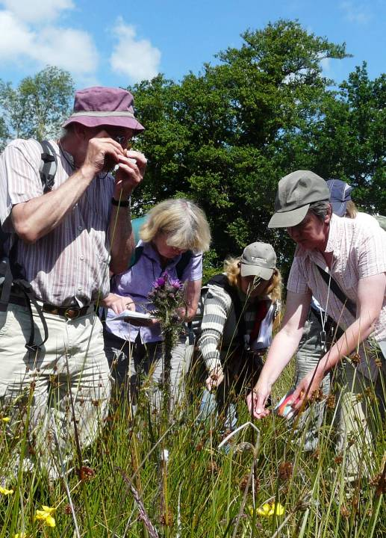
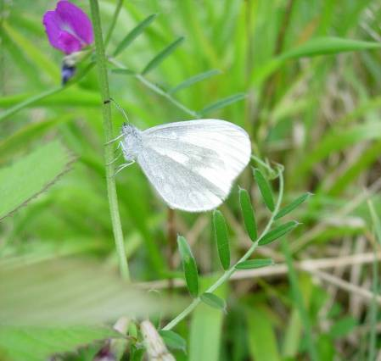
Beth yw Cronfa Dreftadaeth y Loteri? What is the Heritage Lottery Fund?
Notes:
I’m sure that most of you have played the lottery and also heard about the lottery giving some of it’s money to good causes. Heritage Lottery Fund is one of the organizations that give out that money (others are Sports Wales, Arts Council for Wales and BIG lottery). Our focus is obviously on heritage projects.
Up until now, we have funded over 2400 projects across Wales with a total of over £340 million.
Many people think of HLF as funding buildings and artefacts but we are about much more than that – hopefully you’ll get a better idea about that today.

Slide 3
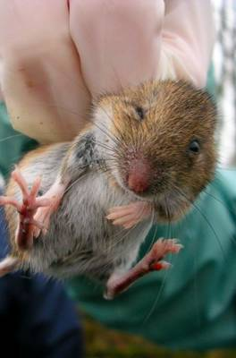
Beth ydym yn ei ariannu? What do we fund?
Prosiectau / Projects
Wedi’i ddiffinio o’r cychwyn / Is defined at the outset;
Dyw e ddim wedi dechrau / Has not yet started;
Bydd yn cyfrannu at fodloni’r canlyniadau / Will contribute to achieving the outcomes we describe

Slide 4
Heritage is…
“everything tangible and intangible that we have inherited from the past, and value enough to want to share and sustain for the future.”
Treftadaeth yw…
“popeth cyffyrddadwy ac anghyffyrddadwy rydym wedi’i hetifeddu o’r gorffennol, ac yn ei gwerthfawrogi’n ddigon i fod eisiau ei rhannu a’i chynnal ar gyfer y dyfodol.”
Notes:
Natural heritage = green spaces, species diversity, habitats etc
Since 1994, HLF has awarded around £400m to over 3,000 projects with a focus on the UK’s natural heritage.

Slide 5
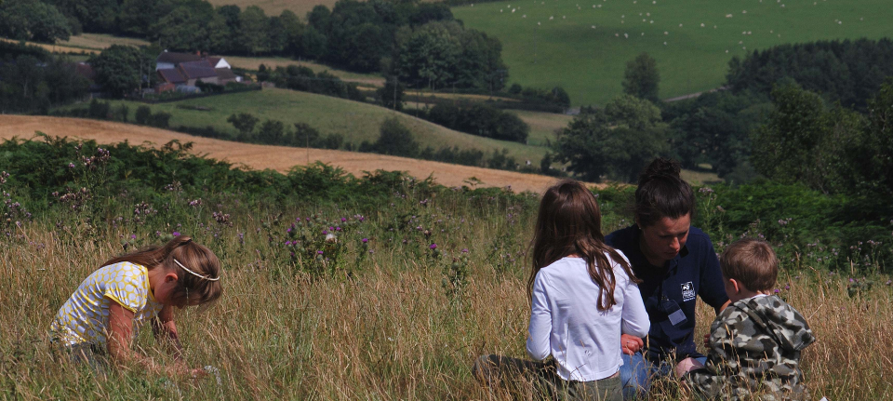
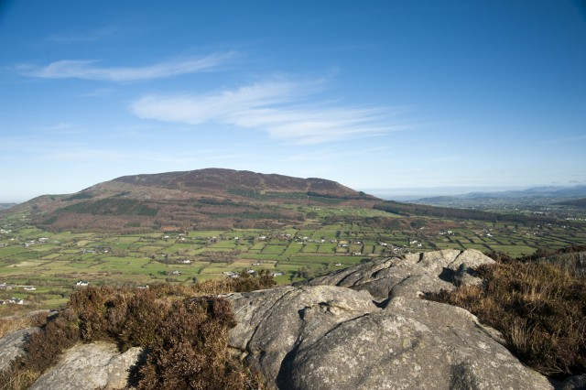
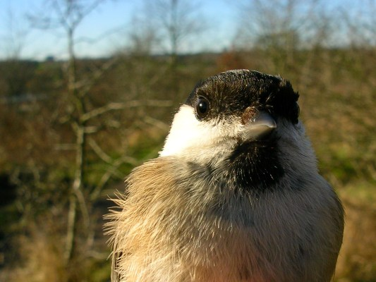
Beth yw treftadaeth naturiol?
What is natural heritage?
Notes:
When we talk about natural heritage we are referring to:
Habitat projects
We are keen that our investment in NH has the greatest impact in conserving and improving habitats that already exist so you may want to consider a project that enhances a number of existing habitats or that helps join-up existing habitats with new planting.
Whilst we can fund the creation of new habitats, our greatest concern is to improve the quality and resilience of existing priority habitats by improving their quality and management, and by the creation of buffer strips, by making habitats bigger or by creating greater connection between other nearby habitats.
Species Project
There are certain species that are now so threatened and their future so fragile that they need individual positive intervention. These are species likely to be identified as UKBAP priority species or in biodiversity strategies. Some have become particularly rare and vulnerable due to damage to their habitats, disturbance, intensification of agriculture or changes to our climate.
We usually see habitat enhancement rather than projects focussed on individual species (although these can be successful e.g. red squirrels, freshwater pearl mussel). If a single species project is proposed it is a good idea to clearly explain why this approach has been taken.
Any project including the re-introduction of species to the UK always requires a robust environmental case to be made which will need to be supported by NRW. The project will need to meet the guidelines extablished by IUCN/SSC Re-Introduction Specialist Group). You will also need to ensure that there are suitable habitats to sustain the species in the long-term without causing adverse impacts on other species.
Geological and Earth projects
The UK is renowned for the diversity and historic significance of its geology. The geodiversity this creates includes rocks, fossils, minerals, landforms, landscapes, geological processes and soils. Geodiversity has had a strong influence on our heritage and our lives, for example geology has dictated where we build castles and towns, where we grow crops etc.
In our open grant programmes, you have the opportunity to convince us of the heritage importance, the risk and how your project addresses this risk

Slide 6
Canlyniadau ar gyfer … / Outcomes for…
Treftadaeth / Heritage | Pobl / People | Cymunedau / Communities
Rheoli’n well / Better managed Mewn cyflwr gwell / In better condition Dehongli a’i hesbonio’n well / Better interpreted and explained Nodi/cofnodi / Identified/ recorded | Datblygu sgiliau / Developed skills Dysgu am dreftadaeth / Learnt about heritage Newid eu hagwedd a/neu ymddygiad / Changed their attitudes and/or behaviour Cael profiad pleserus / Had an enjoyable experience Gwirfoddoli eu hamser / Volunteered time | Effaith amgylcheddol wedi’i lleihau / Environmental impacts will be reduced Bydd mwy o bobl ac ystod ehangach o bobl wedi ymgysylltu â threftadaeth / More people and a wider range of people will have engaged with heritage Bydd eich ardal leol yn lle gwell i fyw, i weithio neu i ymweld / Your local area will be a better place to live, work or visit Bydd eich economi leol wedi cael hwb / Your local economy will be boosted Bydd eich sefydliad yn fwy gwydn / Your organisation will be more resilient
Notes:
These are the specific outcomes that your project could achieve with our investment.
Different combinations can make a successful application; either by contributing a little towards a number of outcomes or contribute a lot towards a few outcomes, but remember it is the quality of the outcomes that we will consider

Slide 7
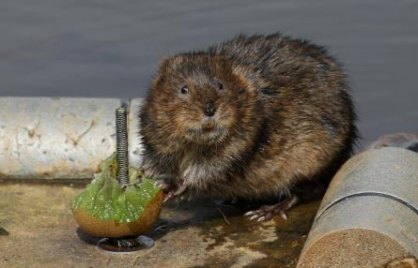
Rhaglenni grant dan £100,000 / Grant Programmes under £100,000
Rhannu Treftadaeth /
Sharing Heritage
£3,000-£10,000
Ein Treftadaeth / Our Heritage
£10,000 - £100,000
Gwreiddiau Ifanc / Young Roots
£10,000 - £50,000
Notes:
Grants under £100,000
Special mention for YR targeted programme

Slide 8
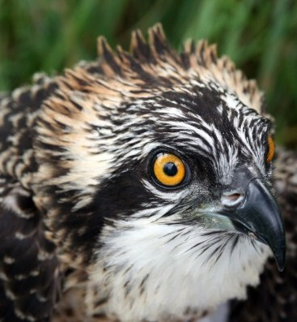
Grantiau Treftadaeth Heritage Grants £100,000 + Proses 2 rownd / 2 Round Process
Grantiau dan / Grants under £1m
Pwyllgor Cymru / Wales Committee
Dyddiadau chwarterol / Quarterly Deadlines
Isafswm arian cyfatebol / Minimum match funding 5%
Grantiau dros / Grants over £2m
Bwrdd y DU / UK Board
Isafswm arian cyfatebol / Minimum match funding 10%
Grantiau dros / Grants over £5m
- Dyddiad Rhag1 / Deadline 1st Dec
Notes:
Grants under £100,000
Special mention for YR targeted programme

Slide 9
Datblygu
Development
Cael caffael ar ymgynghorwyr proffesiynol
Ymgynghori â chynulleidfaoedd newydd
Creu Cynllun Gweithgareddau
Creu Cynllun Rheoli a Chynnal a Chadw
Datblygu briffiau am waith i’w neud gan ymgynghorwyr
Gwneud arolygon arbenigol – ystlumod, asbestos ayyb
Derbyn caniatâd statudol
Datblygu amserlen, costau a llif arian manwl
Sicrhau arian cyfatebol
Procurement of professional advisors
Consultation with new audiences
Create Activity Plan
Create Management and Maintenance Plan
Develop briefs for work to be undertaken by consultants
Undertake Specialist Surveys – Bat surveys, asbestos survey etc
Obtain statutory consents or permissions
Develop detailed timetable, costs and cash flow
Secure match funding
Notes:
All projects over £100,000 are broken into two phases – a development phase and a delivery phase. This is one of the areas that applicants struggle with the most. HLF will provide funding for both phases, and after completing the development activities the grantee needs to submit a new application for the delivery phase that shows us what they have done during development. Development activities include creating an Activity Plan and a Management and Maintenance Plan, undertaking any specialist investigations such as a geophysical or ecological survey, commissioning their lead professional adviser to prepare a full specification and tender package and going to tender for the repair works, obtaining faculty permission for the works, and preparing more detailed costs and a timetable for their delivery phase. In the delivery phase, where the bulk of the grant will be spent, they will undertake all the things they have planned in the delivery phase – the repairs, the activities, and any new building works.

Slide 10
Cyflawni
Delivery
Gwneud gwaith cyfalaf atgyweirio / newydd
Gwaith rheoli cynefinoedd
Gwneud gweithgareddau i fodloni’r canlyniadau Pobl a Chymunedau
Gwerthuso’r prosiect
Undertake repair /new capital works
Habitat management work
Undertake activities to achieve the People and Communities outcome
Evaluate the project
Notes:
All projects over £100,000 are broken into two phases – a development phase and a delivery phase. This is one of the areas that applicants struggle with the most. HLF will provide funding for both phases, and after completing the development activities the grantee needs to submit a new application for the delivery phase that shows us what they have done during development. Development activities include creating an Activity Plan and a Management and Maintenance Plan, undertaking any specialist investigations such as a geophysical or ecological survey, commissioning their lead professional adviser to prepare a full specification and tender package and going to tender for the repair works, obtaining faculty permission for the works, and preparing more detailed costs and a timetable for their delivery phase. In the delivery phase, where the bulk of the grant will be spent, they will undertake all the things they have planned in the delivery phase – the repairs, the activities, and any new building works.

Slide 11
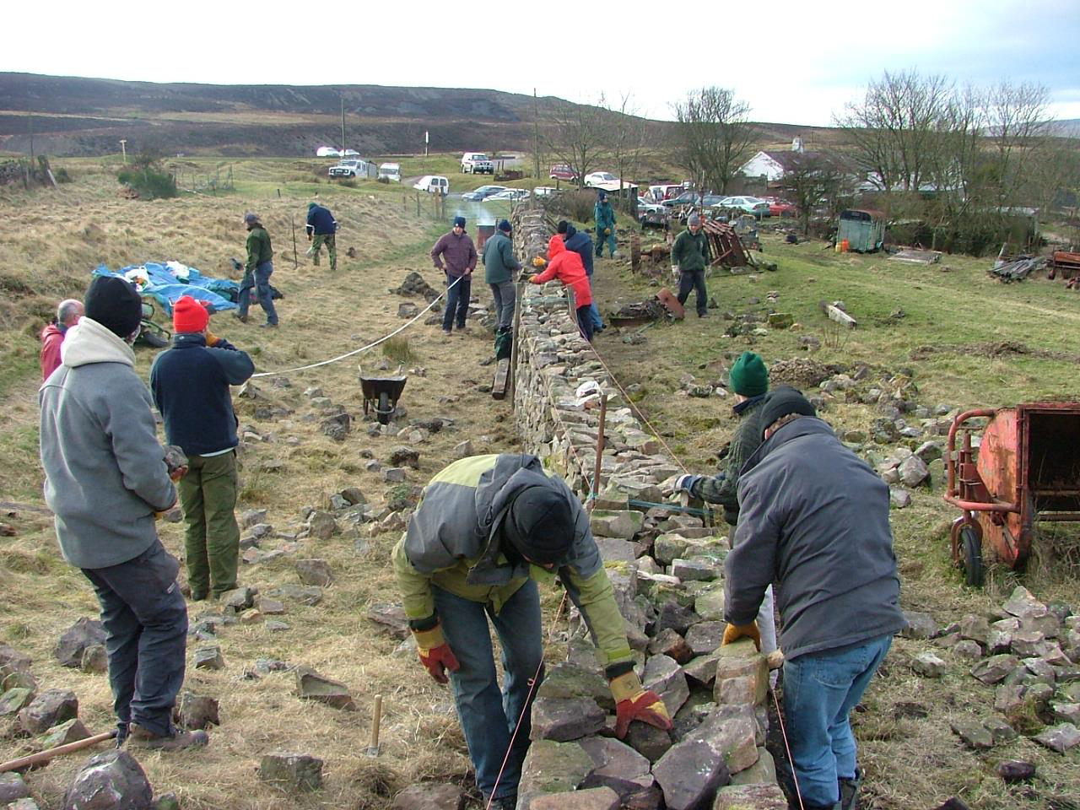
Partneriaethau Tirwedd / Landscape Partnerships £100,000 -£3m Proses 2 Rownd / 2 Round Process
Gwarchod ardaloedd o gymeriad nodedig drwy ddull o
gyd-weithio /
Conserving areas of distinctive landscape character through a partnership approach
Bwrdd y DU / UK Board
Dyddiad cau blynyddol Meh 1 / Annual deadline 1st Jun
Isafswm arian cyfatebol / Minimum match funding 5%
Notes:
Grants under £100,000
Special mention for YR targeted programme

Slide 12
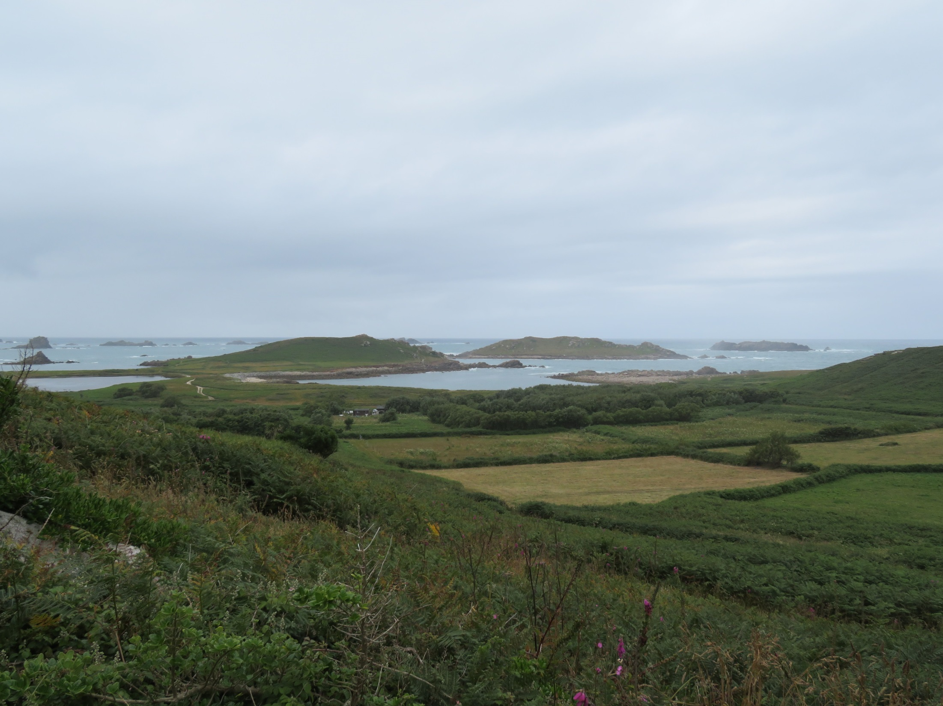
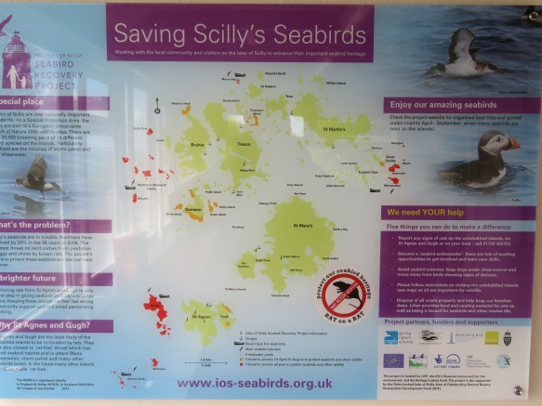
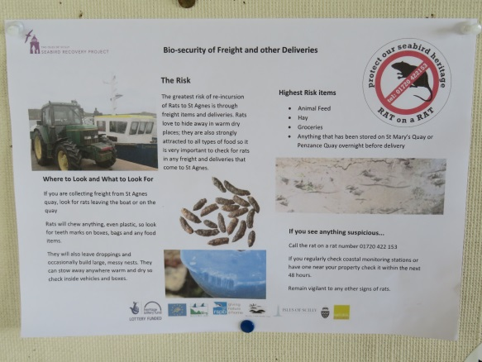
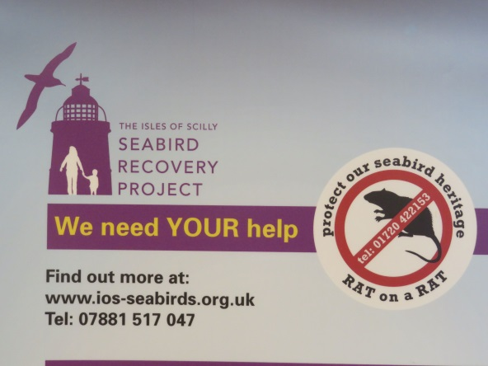
Adfer adar môr Ynysoedd Scilly
Isles of Scilly Seabird Recovery
https://www.youtube.com/watch?v=rTikeqMOAVA

Slide 13
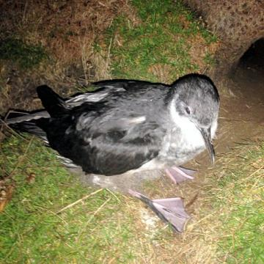
Astudiaeth Achos / Case Study
Adfer adar môr Ynysoedd Scilly / Isles of Scilly Seabird Recovery
RSPB
Cyfanswm Cost / Total Cost: £636,721
Cael gwared o gnofilod /
Rodent removal programme
Rhaglen o weithgareddau /
Programme of activity
Cronfa / Fund | £
Bywyd UE / EU Life | £300,756
CDL / HLF | £269,100
Arall / Other | £66,865
Amserlen / Timescale
Chwe / Feb 2012 Ffurflen cyn ymgeisio / Pre-app form
Maw / Mar 2012 Cais Rownd 1 / Round 1 app submitted
Meh / Jun 2012 Dyfarniad Rownd 1 / Round 1 Award
Medi / Sep 2012 Cais Rownd 2 / Round 2 app submitted
Rhag / Dec 2012 Dyfarniad Rownd 2 / Round 2 Award
Gor / Jul 2016 Gorffen y prosiect / Project completion
Notes:
HG-11-06880
RSPB is currently in delivery for a phase 2 project to eradicate rats from the islands of St Agnes and Gugh. This information relates to phase 1 which has now been completed
The isles of Scilly is the richest seabird colony in England.
Target species: manx shearwater and european storm petrel
Activity includes :
trips to the islands to observe the birds, monitoring etc and a teachers pack
Skype sessions with other remote islands in Scotland and across the world.
Evening guided walks
2 boat trips a year focussed on bird life
Project website
Volunteers trained in seabird and rat surveying and monitoring.
Leaflets
Talks to 50 students
Working with the community with a young persons group and local residents meeting
Point out: risk with development phase
Picture is a link to video

Slide 14
Cysylltwch â ni / Contact us
Cronfa Dreftadaeth y Loteri / Heritage Lottery Fund
Tŷ James William House
9 Plas yr Amgueddfa / 9 Museum Place
Caerdydd /Cardiff
CF10 3BD
Ffôn / Tel: 029 2034 3413
Ebost / Email: cymru@hlf.org.uk / wales@hlf.org.uk
Gwe / Web: cymraeg.hlf.org.uk / www.hlf.org.uk
Twitter: @HLFCymru
Facebook: Cronfa Dreftadaeth y Loteri – Cymru / Heritage Lottery Fund - Wales

Slide 15
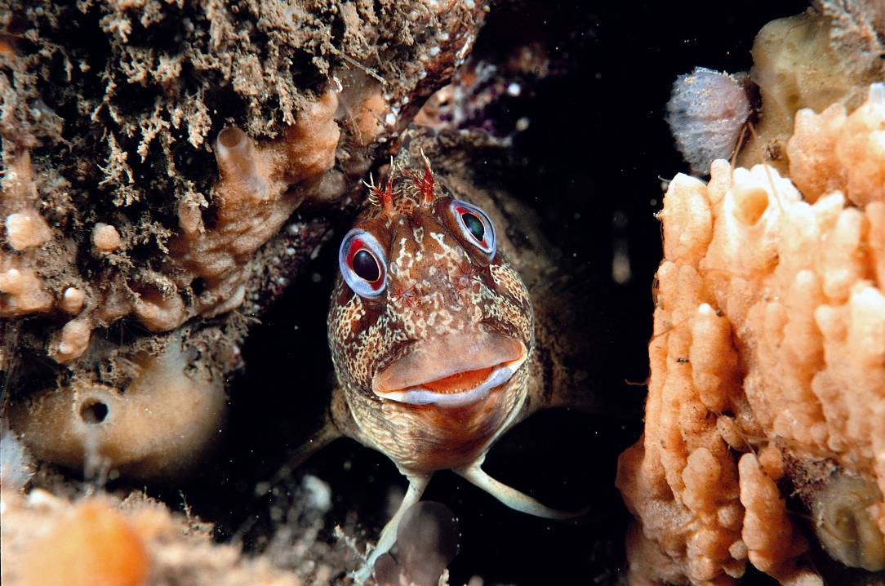
Any questions?
Unrhyw gwestiynau?
Notes:
15
15
There is no doubt we are all facing challenges but I hope the ideas and proposals I have outlined will give you food for thought about how we might be able help to tackle some of these key challenges.
We know that HLF funding can and does make a difference. The trick is to make sure we are able to make the maximum difference by supporting the very best projects that achieve the very best outcomes.
This is your chance to help shape our plans for the future.
Please take time to visit our website at the address shown here and let us have your views.

